Slide 1

CHAPTER 1
Your Buyer Just
Hired an Agent.
Now What?
Everything PMMs assumed about buyers, positioning, and
go-to-market is breaking. Here's what actually changes.
Chris O'Hara · futureofpmm.com · March 2026

Slide 2



THE ASSUMPTION THAT JUST BROKE
For twenty years, product marketing rested on one unspoken axiom.
"The buyer is a human being who will, at some point in the purchase
process, encounter the content you have carefully built for them."
This assumption underpins every messaging framework, content strategy, SEO investment, and nurture sequence in your stack.
Buyer searches
Buyer reads content
Buyer engages
on Google, reads your page
case studies, demo videos
fills form, books a call
✓ PMM content reaches this stage
✓ PMM content reaches this stage
✓ PMM content reaches this stage

Slide 3


MEET SARAH — AND HER AGENT
A real scenario playing out at enterprise companies right now.
Monday 9am
Monday 9:04
Monday 9:11
Monday 10am
Agent Dispatched
Autonomous Research
Shortlist Generated
Sarah Reviews
Sarah's AI procurement
assistant gets the brief:
evaluate analytics platforms
Queries structured DBs,
G2 rankings, schema-marked
content, analyst reports
3-vendor shortlist created.
Comparison matrix built.
Recommendation drafted.
Opens her laptop. Shortlist
already waiting. Vendors
not on it: invisible.
✗ Your case study, demo video, and product page were never seen. The shortlist was set 2 minutes into Monday morning.

Slide 4
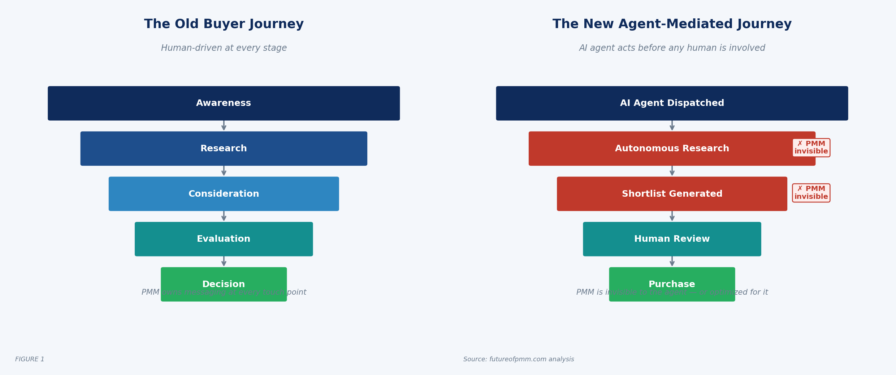
THE BUYER JOURNEY HAS BEEN REWRITTEN
Source: futureofpmm.com — The Future of Product Marketing, Chapter 1

Slide 5
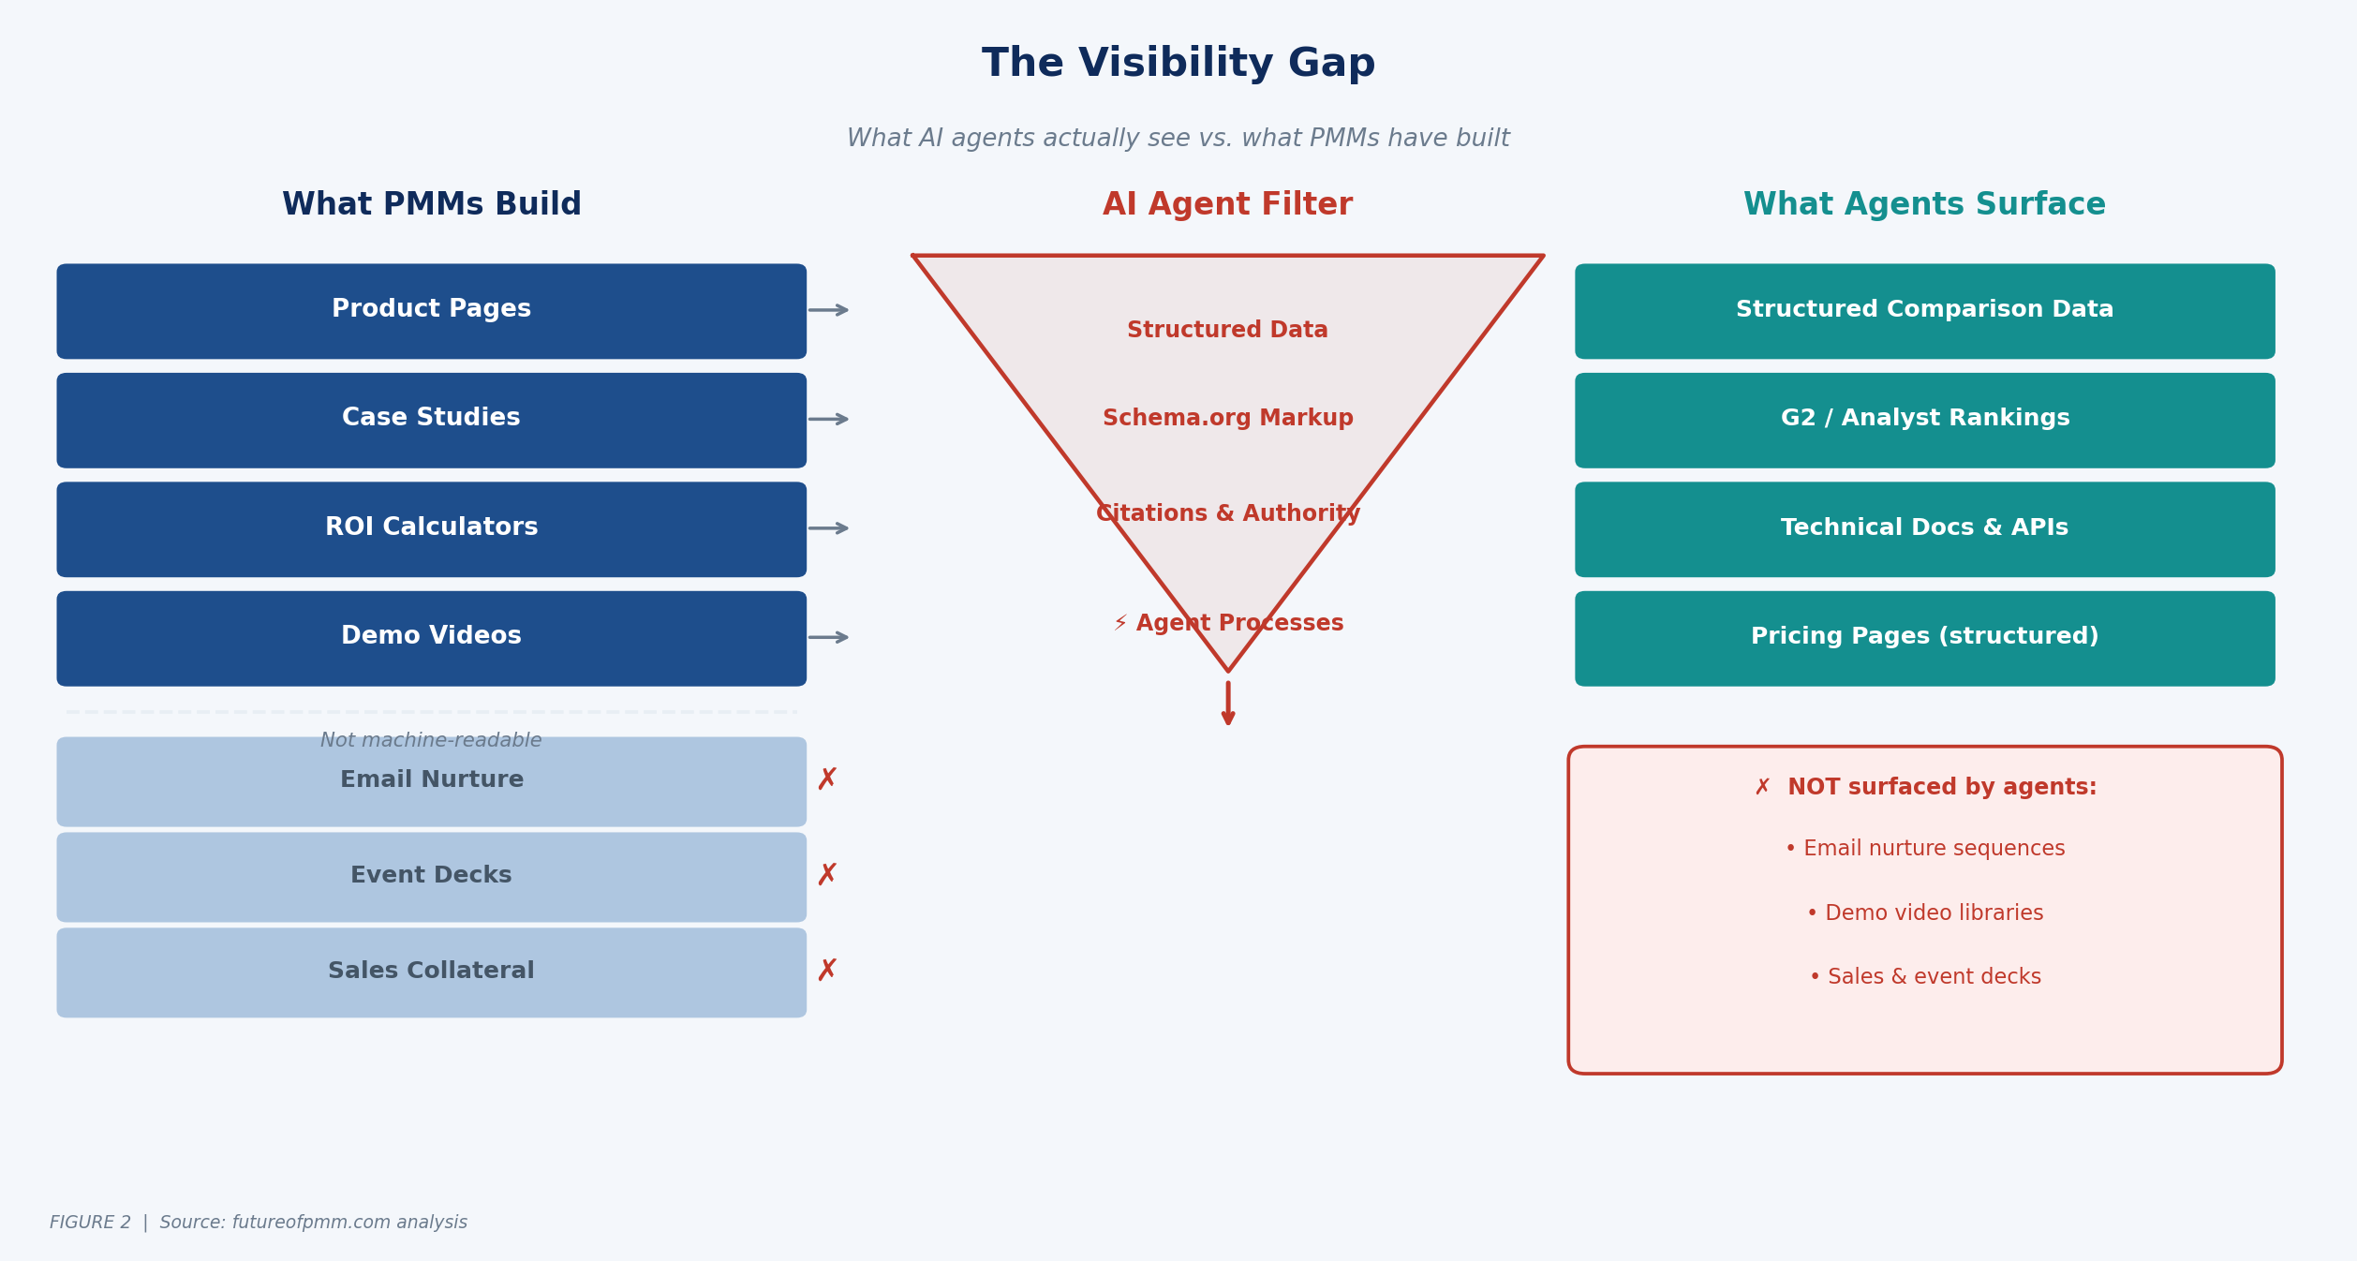
THE VISIBILITY GAP
Source: futureofpmm.com analysis · The assets agents surface are already within PMM's scope — they just haven't been treated as strategic outputs.

Slide 6
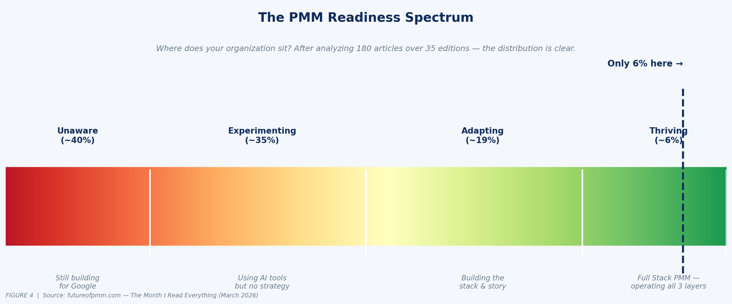
THE SIX PERCENT PROBLEM
After 35 editions and 180 articles synthesized — the signal is unmistakable.
6%
of B2B marketing
teams are ready
40% are unaware the transition is happening — still optimizing for Google
35% are experimenting with tools but have no underlying strategy shift
6% have made all three moves — and are pulling away from the field

Slide 7
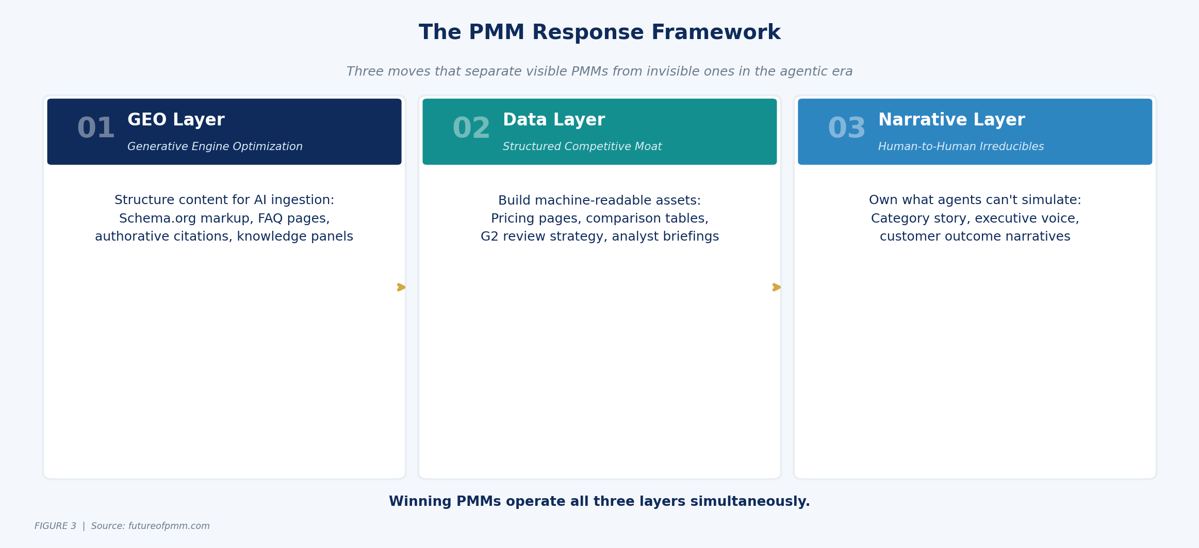
THE PMM RESPONSE: THREE MOVES
Winning PMMs operate all three layers simultaneously. Most organizations stall at Move 1, or skip directly to Move 3.

Slide 8

MOVE 01 · BUILD THE GEO LAYER
Generative Engine Optimization is not SEO with a new name. The signals are fundamentally different.
Signal | SEO (Google) | GEO (AI Agents)
Optimizes for | PageRank / inbound links | Schema markup / citation authority
Key content | Keywords & density | Structured FAQ + knowledge panels
Review signals | None directly | G2 / Gartner Peer Insights (heavily weighted)
Pricing | Not a ranking factor | Structured pricing = agent-processable
Technical docs | Helps crawlability | Core agent evaluation signal
Quick Win · This Week
Add structured FAQ markup (FAQPage schema) to your top 5 category pages.
Single highest-ROI GEO action for most B2B PMM teams. Can be done in a week.

Slide 9


MOVE 02 & 03 · DATA LAYER + NARRATIVE LAYER
02
Build the Data Layer
03
Own the Narrative Layer
Structured Competitive Moat
Human-to-Human Irreducibles
Treat your G2 profile as a first-class PMM output — not operational maintenance
This is what AI cannot replace — and the noise floor rising makes it more valuable
Structure your pricing page with schema markup (invisible JS = agent-invisible)
Category framing: make your position feel inevitable, not chosen
Analyst relations is now partly a data infrastructure project
Customer outcome narratives that only you have the relationships to make real
Competitive comparison pages with machine-readable markup outperform narrative pages
Moves 1 & 2 get you in the room. Move 3 is how you win.
⏱ 30–60 day priority
⏱ Ongoing investment

Slide 10
WHAT TO DO THIS WEEK
The gap is compounding. But it closes with specific, sequenced moves — not a multi-quarter strategy.
This week
Next 30 days
Next 60 days
Next 90 days
Run the Agent Audit
Implement Schema Markup
Audit G2 + Gartner Presence
Build Structured Competitive Content
Ask an AI assistant to research your category and find top vendors. Note where you appear, what it says, and what it cites. This is your baseline.
FAQPage and SoftwareApplication schemas on your top 5 pages. Highest-ROI GEO action for most B2B PMM teams.
Run a review generation campaign. Ensure your profiles surface the right features and use cases.
One genuine comparison page with machine-readable markup. Not 'Why Us.' An honest, structured comparison an agent can parse.
futureofpmm.com · Chris O'Hara · The Future of Product Marketing

